Slide 1
2 SONATA-focused sessions on SOFTNETWORKING
SOMA: Presentation-focused project overview = session on Monday afternoon (16:30 - 18:00)
DEMO: Demo- & hands-on focused SONATA software overview = session on Monday evening (18:40 - 20:30)
a) you are all invited to join and actively participate in the hands-on session!!
b) check https://github.com/sonata-nfv/son-tutorials/ for preparing active participation

Slide 2
DEMO session agenda
Demo overview & vEPC background – Wouter Tavernier
SONATA SDK hands-on – Steven Van Rossem
Break (10 min)
SONATA Service Platform demo – Thomas Soenen
Questions & discussion

Slide 3


Demo overview & vEPC service background
Dr. Wouter Tavernier
HORIZON 2020

Slide 4

Agenda
Objectives
Virtualized Evolved Packet Core Service

Slide 5
Demo session objectives
Demonstrate the SONATA toolkit for developing and designing a realistic virtualized service in a 5G context
Use of the SONATA Software Development Kit for developing and pre-evaluating a SONATA service based on an existing Evolved Packet Core (EPC) implementation
Use of the SONATA monitoring tools to assess resource usage of the deployed vEPC service
Demonstrate the use of the SONATA Service Platform using a real Virtual Infrastructure setup with the developed service

Slide 6
DEMO session agenda
Demo overview & vEPC background – Wouter Tavernier
SONATA SDK hands-on – Steven Van Rossem
Break (10 min)
SONATA Service Platform demo – Thomas Soenen
Questions & discussion

Slide 7
DEMO session agenda
Demo overview & vEPC background – Wouter Tavernier
SONATA SDK hands-on – Steven Van Rossem
Break (10 min)
SONATA Service Platform demo – Thomas Soenen
Questions & discussion

Slide 8
DEMO session agenda
Demo overview & vEPC background – Wouter Tavernier
SONATA SDK hands-on – Steven Van Rossem
Break (10 min)
SONATA Service Platform demo – Thomas Soenen
Questions & discussion

Slide 9
Backup

Slide 10
Agenda
Objectives
Virtualized Evolved Packet Core Service

Slide 11
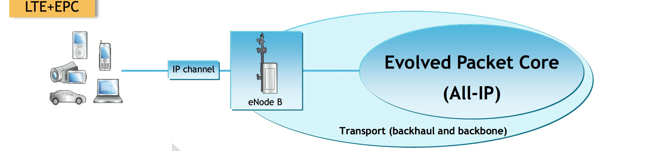
Evolved Packet Core (EPC)
What is EPC?
end-to-end IP network functionality in the network
necessary for enabling connectivity of mobile devices since LTE (4G) in moving conditions, with other mobile devices and with the external network
functionality: mobility management (MME), gateways to other networks (S/PGW), maintaining subscriber/user data (HSS)

Slide 12
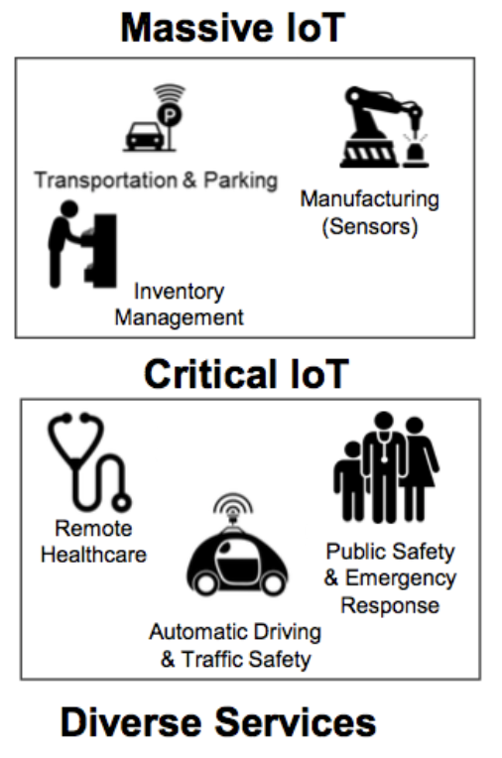

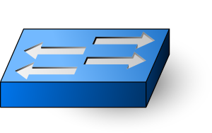






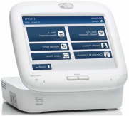


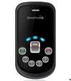





EPC using SDN/NFV for 5G services
Data Plane must be Distributed
Control Plane can be Centralised
LOCAL PoPs
REGIONAL DATA CENTRES
v
v
vEPC
Service Domain
FUNCTION (Software defined)
MME
SGW
PGW
HSS
Network Domain
HW and SW decoupling
HW and SW decoupling
OS + Hypervisor
OS + Hypervisor
Infrastructure Domain
COTS HW
COTS HW
CAPACITY (Homogeneous infrastructure)
SDN Switching
SDN Switching
Interconnection
Devices
Radio
Places
Fiber
Users
Access
Aggregation
Local Points of Presence
Core
Regional Data Centres
Capillarity, Capacity, Mobility support
Multiplexing
Manage users and sessions, Local managed services
Switching, Transport
Control functions, Regional managed services
Notes:
http://www.rcrwireless.com/20170305/evolved-packet-core-epc/20170305evolved-packet-core-epcvirtualized-epc-5g-internet-of-things-tag17#prettyPhoto/0/

Slide 13
vEPC service - Overview
eNB
S1-MME
MME
S6a
HSS
PCRF
S11
Gx
Rx
X2
S-GW C
S5/S8-C
P-GW C
S-GW U
P-GW U
public internet
S1-U
S5/S8-U
Gi/SGi
eNB
bearer

Slide 14
Main procedures
(re-)attach: when Idle UE powers on or wants send traffic
authentication via MME
session setup with S-GW
bearer setup
Tracking Area Update: periodic location update from UE to MME
Paging: waking up Idle UE when data needs to be delivered
Handover: teardown change connection of UE with eNodeB to other eNodeB
Detach: tear down of bearer
Notes:
https://www.eventhelix.com/lte/attach/LTE-Attach-Messaging.pdf

Slide 15
vEPC - Bearer
virtual concept for a tunnel classifying UE traffic across the network
focus on EPS bearer = connection within EPC
sub-bearers:
radio bearer
S1 bearer
S5/S8 bearer
Notes:
http://go.radisys.com/rs/radisys/images/paper-lte-protocol-signaling.pdf

Slide 16
Radio Access Network (RAN)
eNodeB (eNB) = mobile tower/antenna infrastructure, with main functionalities:
radio resource management
compression/encryption to UE
routing to S-GW
User Equipment (e.g. mobile phone)
Mobile Termination
eNB
S1-MME
EPC
X2
S1-U
eNB
Radio Access Network
eNB
S1-MME
MME
S6a
HSS
PCRF
S11
Gx
Rx
X2
S-GW C
S5/S8-C
P-GW C
S-GW U
P-GW U
public internet
eNB
S1-U
S5/S8-U
Gi/SGi

Slide 17
vEPC– Mobility Management Entity (MME)
Handles all control operations (attachment, handover, etc.)
Maintains connection to eNodeBs through S1AP interface, HSS through S6 interface and serving GW through S11 interface as per 3GPP standards.
eNB
S1-MME
MME
S6a
HSS
S11
X2
S-GW C
S-GW U
S1-U
eNB

Slide 18
vEPC – Home Subscriber Server (HSS)
database for UE (User Entity) authentication information
eNB
S1-MME
MME
S6a
HSS
PCRF
S11
Gx
Rx
X2
S-GW C
S5/S8-C
P-GW C
S-GW U
P-GW U
public internet
S1-U
S5/S8-U
Gi/SGi
eNB
bearer
18

Slide 19
vEPC – Policy and Charging Rules Function (PCRF)
database for UE charging and policy related information
eNB
S1-MME
MME
S6a
HSS
PCRF
S11
Gx
Rx
X2
S-GW C
S5/S8-C
P-GW C
S-GW U
P-GW U
public internet
S1-U
S5/S8-U
Gi/SGi
eNB
bearer

Slide 20
vEPC – Serving GW (S-GW) & Packet Data GW (P-GW)
S-GW
routes and forwards user data packets
the mobility anchor for the user plane during inter-eNodeB handovers
For idle state UEs, the SGW terminates the downlink data path and triggers paging when downlink data arrives for the UE.
manages and stores UE contexts, e.g. parameters of the IP bearer service
P-GW
provides connectivity from the UE to external packet data networks by being the point of exit and entry of traffic for the UE
performs policy enforcement, packet filtering for each user, charging support, lawful interception and packet screening
Notes:
https://en.wikipedia.org/wiki/System_Architecture_Evolution

Slide 21
Using the SDK for developing an&d deploying a vEPC
https://github.com/networkedsystemsIITB/NFV_LTE_EPC
Authors
Sadagopan N S, Master's student (2014-2016), Dept. of Computer Science and Engineering, IIT Bombay.
Prof. Mythili Vutukuru, Dept. of Computer Science and Engineering, IIT Bombay.

Slide 22
DEMO session agenda
Demo overview & vEPC background – Wouter Tavernier
SONATA SDK hands-on – Steven Van Rossem
Break (10 min)
SONATA Service Platform demo – Thomas Soenen
Questions & discussion

